Slide 1
HERMES
MADE BY:
SANDESH CHINCHOLE
AJINKYA DATALKAR
VIJAY PAWAR
SUJAL PATEL
SIDDHANT SHINDE

Slide 2
CONTENTS
INTRODUCTION
ARCHITECTURE
USER STORIES AND ACCEPTANCE CRITERIA
PRODUCT BACKLOG
SPRINT BACKLOG
RETROSPECTIVE
BURNDOWN CHART
WIKI-PAGE
LIVE DEMO

Slide 3
INTRODUCTION
The Point of Sale (POS) or Point of Purchase (POP) is the time and place where a retail transaction is completed. At the Point of Sale, the merchant calculates the amount owed by the customer, indicates that amount, may prepare an invoice for the customer (which may be a cash register printout), and indicates the options for the customer to make payment.
It is also the point at which a customer makes a payment to the merchant in exchange for goods or after provision of a service. After receiving the payment, the merchant may issue a receipt for the transaction, which is usually printed but is increasingly being dispensed with or sent electronically.
The point of sale system that we developed is for stores that sell dry fruits, chocolates, cookies, chips, baked products, etc. The price of most of the items will depend on the weight of the item. We are going to develop the software using C++, JavaScript, CSS, HTML, PHP, and QML. Finally, we will be creating the installer for the software using NSIS.

Slide 4
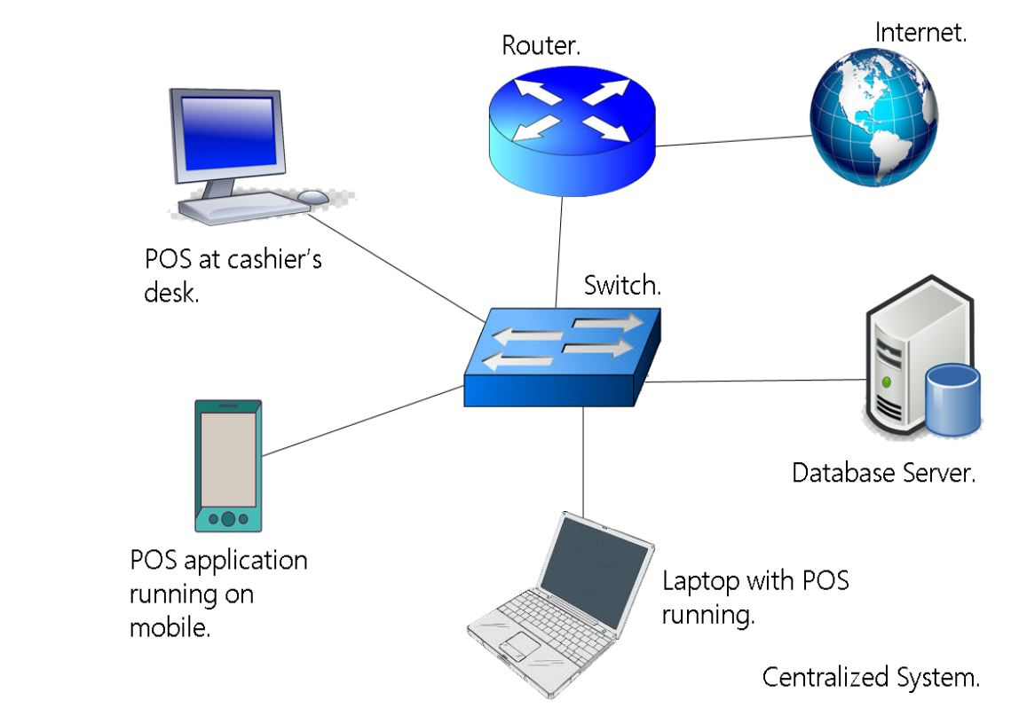
ARCHITECTURE

Slide 5
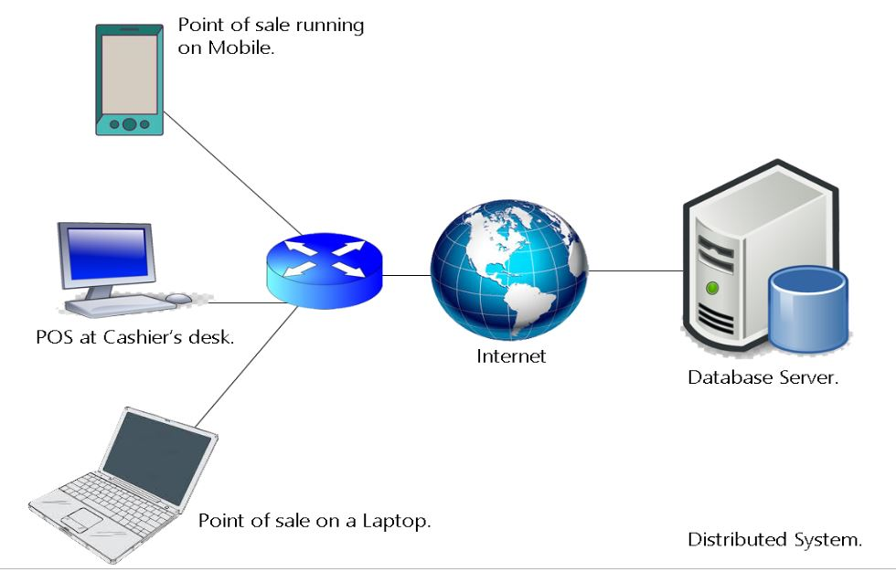

Slide 6
USER STORY AND ACCEPTANCE CRITERIA
USER STORY | ACCEPTANCE CRITERIA
As an Employee, I need the display screen so I can see the scanned item on the screen so that I can make sure I scanned all the items. | Ensure the Employee is able to: Connectivity between scanner and display Access to update data
As a Customer, I need display to see the scanned item and it’s price so that I can see all the scanned item and pricing. | Ensure the customer is able to: See scanned item on display Product Price.

Slide 7
USER STORY AND ACCEPTANCE CRITERIA
USER STORY | ACCEPTANCE CRITERIA
As an Employee, I need a customer signature at the end of the Purchase so that I have the transaction history. | Ensure the Employee is able to: Store the Signature to data base. Store the information that which payment option is selected.
As a Customer, I want to ensure that the employee charged the right amount so that I can select the method of paying. | Ensure the Customer is able to: Final payable amount Payment option

Slide 8
USER Story AND ACCEPTANCE CRITERIA
USER STORY | ACCEPTANCE CRITERIA
As a store manager, I need information and contact detail of my all vendors for purchasing so that I can make an order. | Ensure the store Manager is able to: Log in to POS system Access to Vendor detail Access to direct order
As a store manager, I need weekly email for special pricing so that I don’t miss any order to place. | Ensure the store Manager is able to: Access to email

Slide 9
PRODUCT BACKLOG
SPRINT 4
Daybook frontend
Daybook Backend

Slide 10
SPRINT BACKLOG 4
To Do | Doing | Done
Day book screen backend
Purchase screen frontend
Purchase screen backend
Solve Barcode Screen bugs
Solve Billing Screen bugs
Purchase screen bugs
Day book screen frontend

Slide 11
RETROSPECTIVE
SPRINT 4:
What went well
Removed all bugs
Good time management during 4 sprints
Improved efficiency due to team member’s collaboration
What could be improved
Better Planning and Implementation through Agile software development practices
Better tasks division among scrum team

Slide 12
BURNDOWN CHART

Slide 13
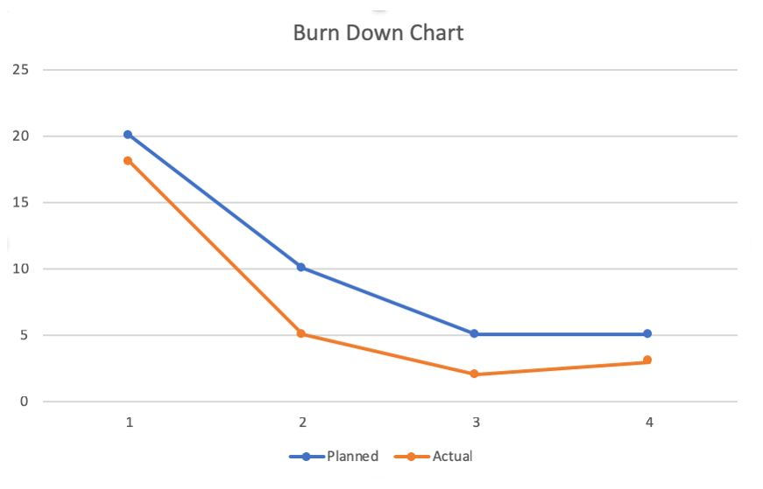
BURN DOWN CHART

Slide 14
Features:
Purchase Screen
Day Book
Keeping track of purchase price of inventory items.
Billing Screen
Recording history of sold items.
Ordering inventory
Generate and print bill
Keep track of sales and purchases
Keep track of payments

Slide 15
Demo Video
Desktop
Mobile app

Slide 16
Wiki-Page
https://github.com/sujal9310/POS-system/wiki

Slide 17

Thank you

